Slide 1




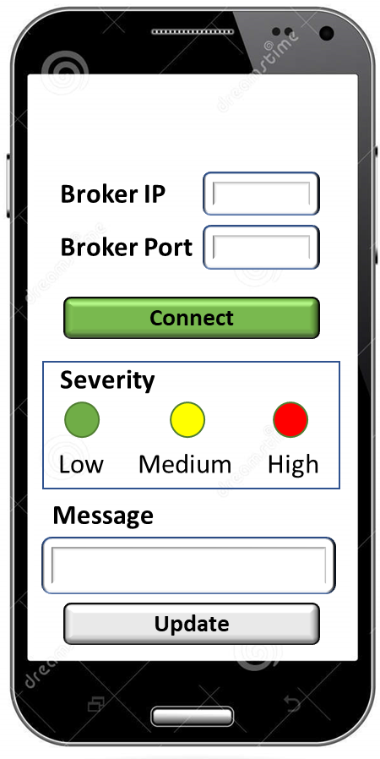




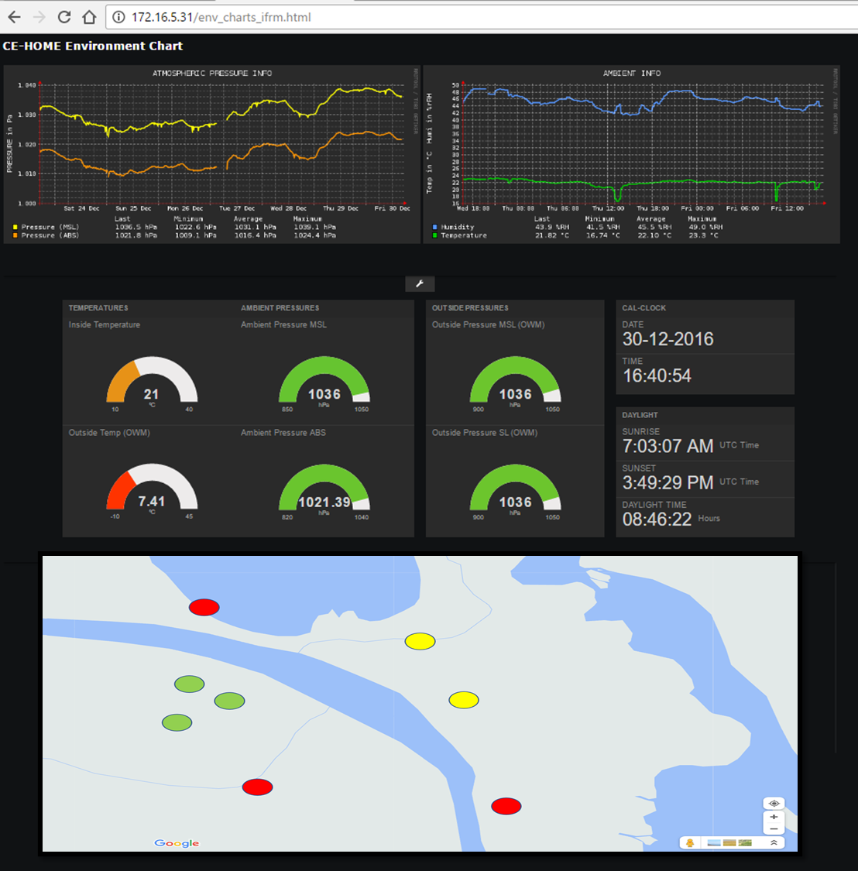

Real Android Client
Bridge Broker Server
subscribe topic: rescue/severity
connection name: drone
persist publishes inside an MSQL database
publish topic: rescue/severity
Central Broker Server
publish topic: rescue/severity
publish topic: rescue/severity
:1883
:1884
subscribeMSQL.py
Make SQL queries
IP 1
IP 2
IP 3

Slide 2
subscribe topic: rescue/severity
Change the basic configuration of mysql
Open the port in the azure firewall
persist publishes inside an MSQL database
Central Broker Server
publish topic: rescue/severity
:1884
subscribeMSQL.py
Make SQL queries
IP 3
Pycharm

